Slide 1


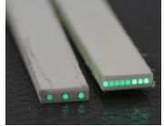
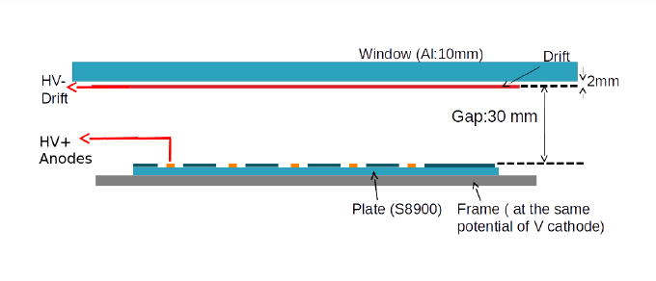
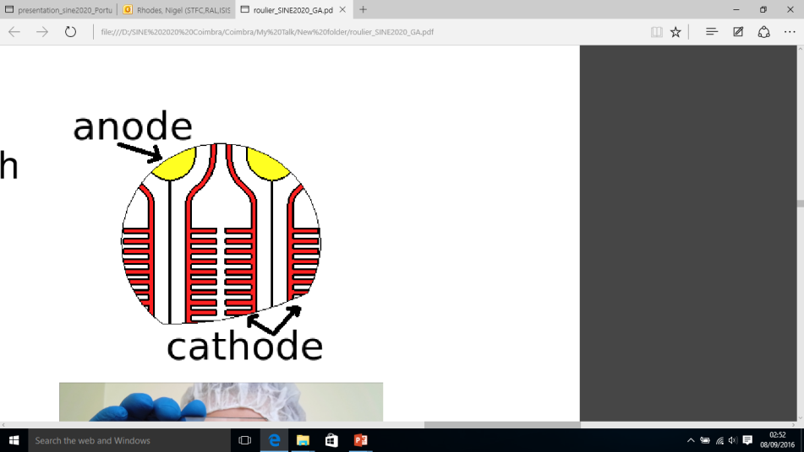
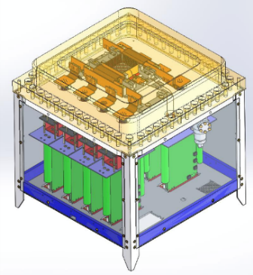
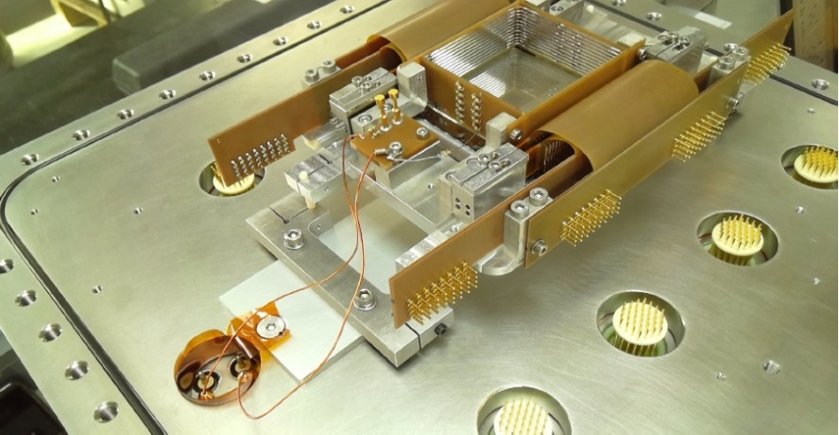
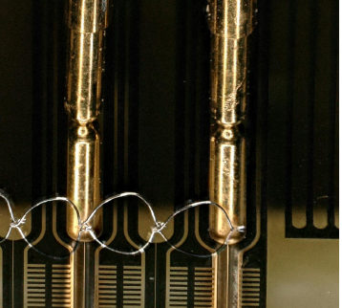
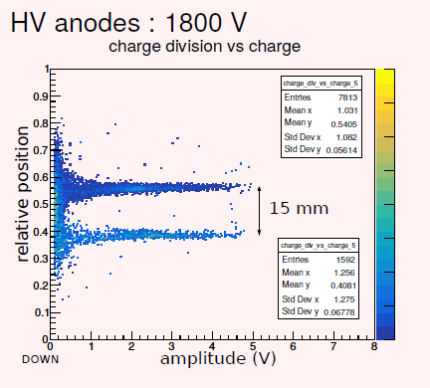
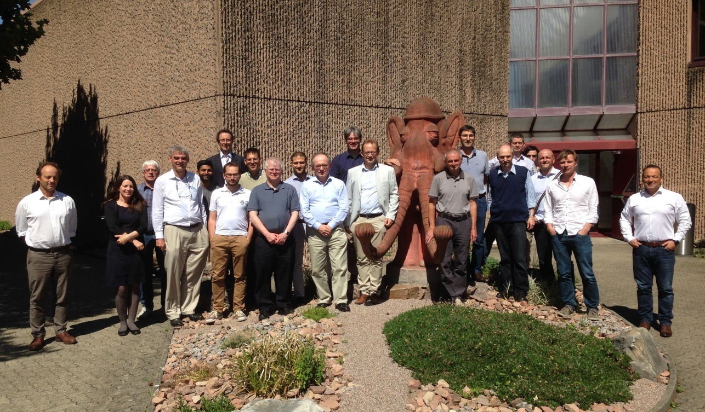









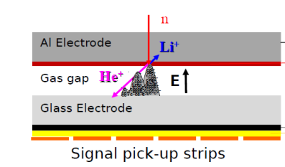
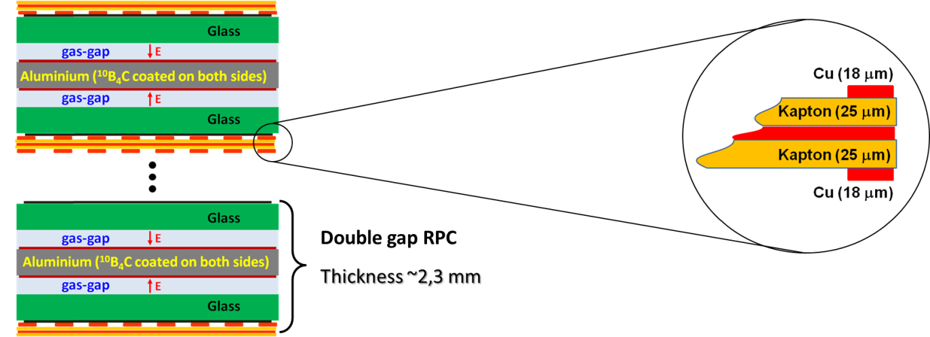
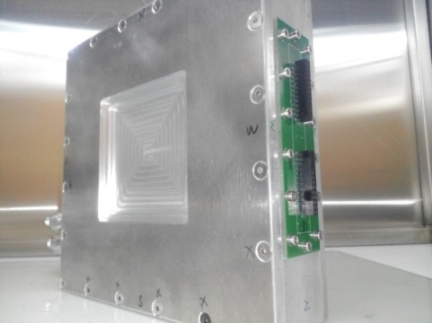
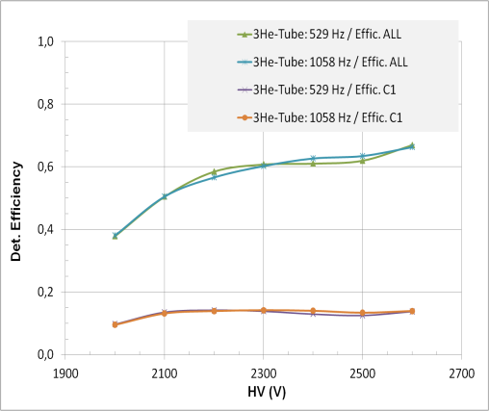
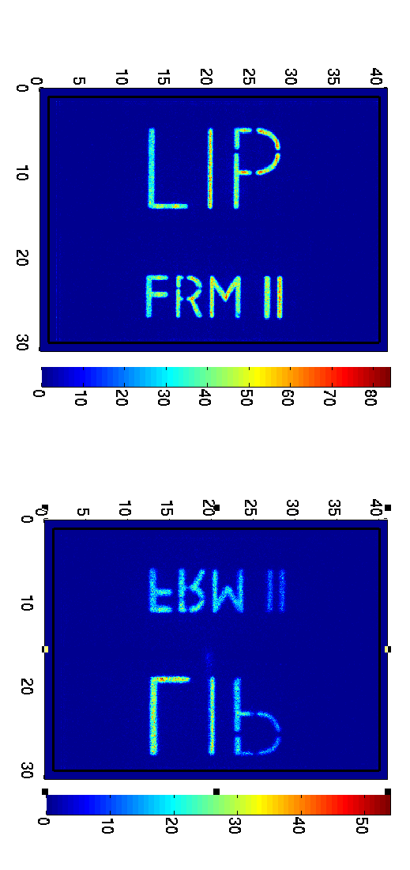
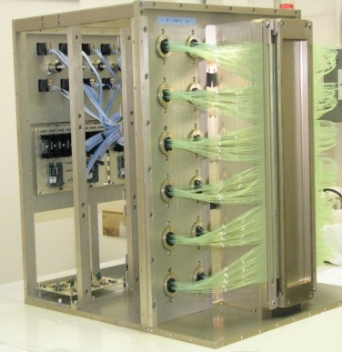
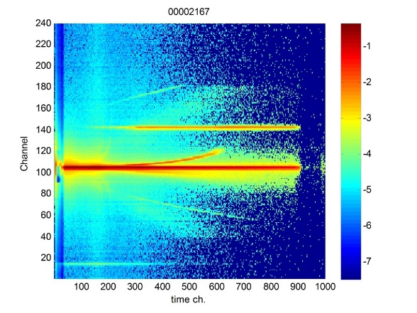
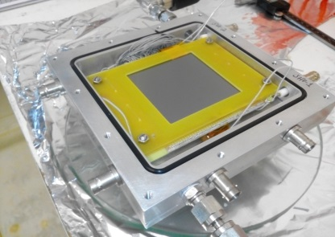
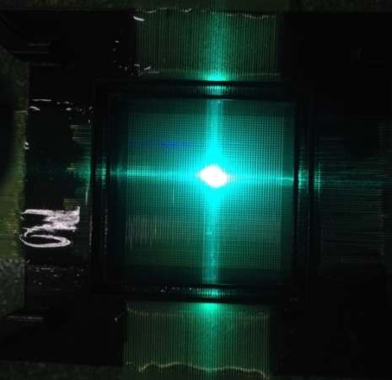
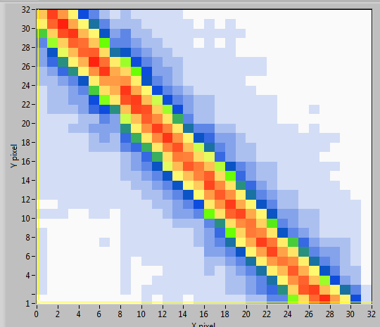
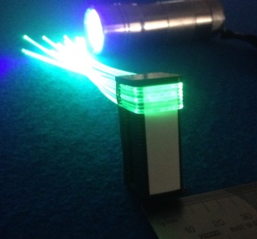
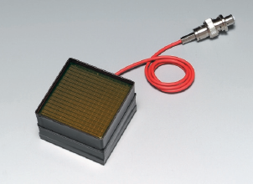
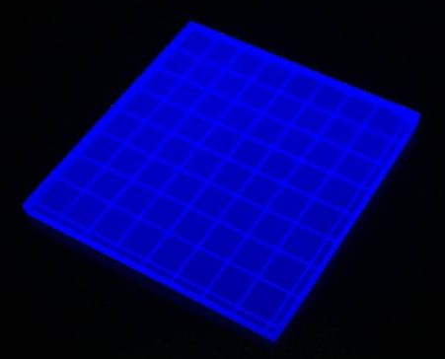
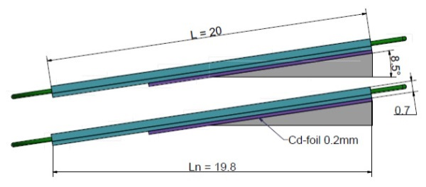

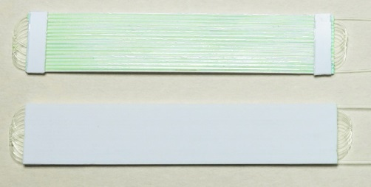

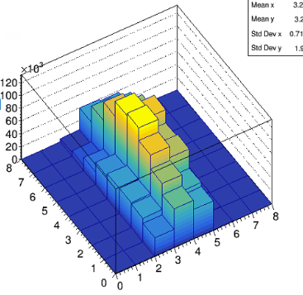
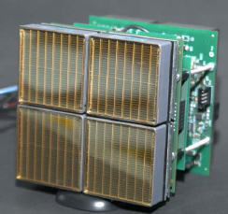
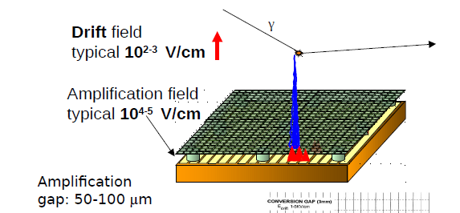
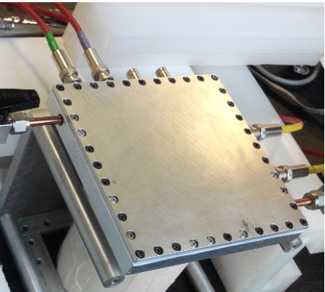
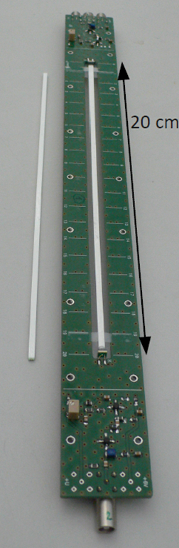
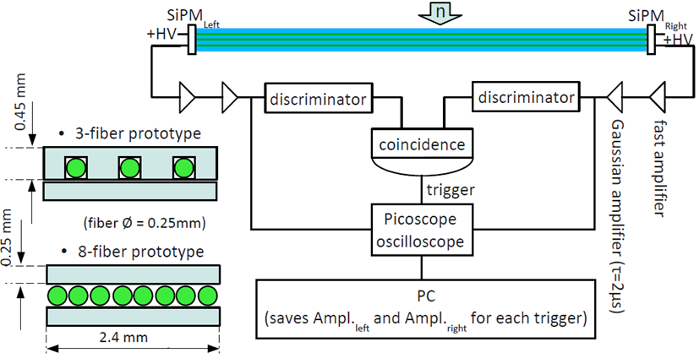
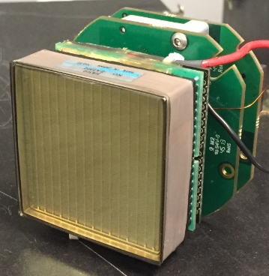
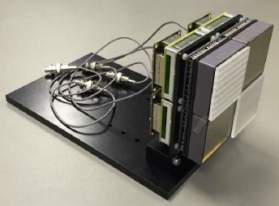
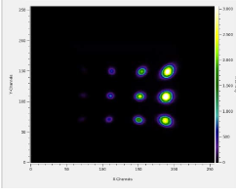
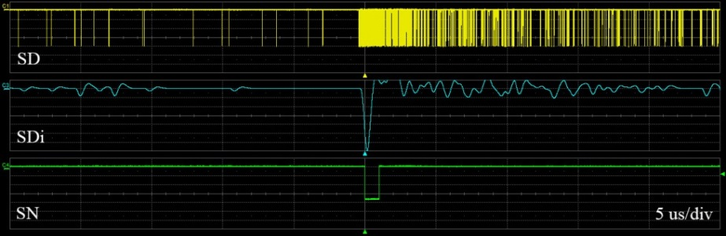
NEUTRONS FOR EUROPE
DETECTORS
Task 9.1: Involving industry and the wider European neutron and muon detector communities in detector development (All)
INTRODUCTION
The European Spallation Source, (ESS), now under construction in Sweden, will produce intense beam of neutrons for determining the structure and dynamics of materials. Such beams will challenge current neutron detector technology. This is particularly true for reflectometry applications at the ESS, where detectors will need to cope with neutron rates that are up to 100 times faster than at present neutron sources. This aim of this work package is to develop fast, high resolution neutron detectors for reflectometry applications which are able to cope with requirements of the ESS. In addition high timing resolution and high rate detectors will be developed for MuSR, a related technique providing complimentary information. The need for high rate, high resolution detectors are common to all neutron and muon sources; therefore this proposal is of wide synergetic benefit across the European neutron and muon facilities.
AIMS
Develop neutron detectors for reflectometry applications relevant to the ESS
Spatial resolution 0.5 – 3 mm
Time resolution better than 100 µs
Local instantaneous rate capability of several kHz/mm²
Evaluation of the latest silicon PMs and scintillator readout devices for MuSR, particularly with regard to rate capability and fast timing applications
TASKS
  Task 9.1: Involvement of industry and the wider European neutron and muon detector communities in detector development
  Task 9.2: Development of scintillation detectors with high rate capability for reflectometery
  Task 9.3: Development of a 3He based microstrip gas chamber with a novel 2D readout
  Task 9.4: Emergent Detector Technologies for neutron scattering and MuSR
  PARTNERS
Task 9.3 Development of a 3He based microstrip gas chamber with a novel 2D readout (ILL)
The number of commercial companies developing neutron detectors is very limited.
The reasons are well understood:
The market is small Development is time consuming
Development requires access to neutrons No single solution fits all requirements
Of equal concern is the fact that many detectors rely on a few key components and these are often manufactured by one or two companies.
3He, Schott 8900 glass, MSGC lithography, neutron sensitive scintillator, WLS fibre, vacuum PMTs etc.
To explore the appetite for industry to be more involved in detector development
Industrial companies with an interest in neutron detector technology were invited to an extended RTD meeting
Representatives from 6 companies attended
The work of this work package was presented
Companies were given time to describe their portfolios and interests
Some messages were encouraging
Bring us in early
Tell us what you require
Keep us involved
However, there is still much work to be done.
Microstrip gas chambers, (MSGC), offer high rate capability.
However, MSGCs are intrinsically 1D position sensitive devices
In this task the ILL is making the microstrip 2D position sensitive by using cathodes.
The resistance of the cathode is kept high by controlling the width of the cathode
The collection area of the cathode is kept high by the novel shape of the cathode.
The prototype detector has been designed and constructed and first tests have been carried out
MSGC schematic
Novel cathode layout
Detector Design
First detector constructed
Active area 64 x 76 mm²
Wire bonding of anodes solved sparking issue
FWHM < 2 mm
Task 9.4: Emergent Detector Technologies for neutron scattering and MuSR
First extended RTD meeting held at PSI on 13-14 June
SINE 2020 WP9 partners and industrial representatives
Task 9.4.1 Development of neutron sensitive resistive plate chambers, RPCs, (LIP)
RPCs are used extensively in High Enegy Physics.
Provide large areas (eg CMS 3000 m2) with high timing (1 ns – 50 ps) and high position resolution (~100 μm).
LIP is developing neutron sesitive RPCs by coating the electrodes with ¹⁰B₄C.
Neutron tests are carried out in collaboration with TUM at FRM II. ¹⁰B₄C coating of glass is carried out by the ESS.
Extensive simulations carried out: Two single-layer 70 x 70 mm² detectors constructed. 12% efficiency at 4.7 Å and 0.25 mm FWHM resln.
Efficiency improved with stack of ten double-layer RPCs -twenty layers of ¹⁰B₄C
Task 9.2 Development of scintillation detectors with high rate capability for reflectometry
9.2.1 Development of a scintillation detector with wavelength shifting (WLS) fibre readout (STFC)
Task 9.4: Emergent Detector Technologies for neutron scattering and MuSR cont.
Task 9.4.3 Development of silicon photomultiplier based detectors for MuSR (STFC, PSI)
ZnS:Ag/⁶LiF scintillator coupled to green enhanced 64-channel PMT
Coded array of WLS fibre
Linear position sensitive detector of this type used on OffSPEC ( 0.5 x 60 mm² resln.)
  Problem: most of the data goes into 2 of the 192 PMT pixels
  Continuous source requires excellent timing resolution
  Pulsed source requires excellent rate capability (many positrons per detector per pulse)
  Three pronged approach
    Testing of scintillation detector with SiPM on muon beam line
    Testing of SiPM with laser response
    Modeling of detector response
Solution1
2D position sensitive detector (0.5 x 0.5 mm²). Adjacent horizontal and vertical detector pixels deliberately coded to different PMT pixels
Solution 2
  High aspect ratio 2D (0.5 x 10 mm²) with sharp bent fibres
Both solutions distribute high count rate over many PMT pixels rather than a few, increasing rate capability
Detector dead time dependent on:
  Positron flux on detector
  No. of incident photons on SiPM
  No. of cells of SiPM
  Recharge time of device
  Signal processing method adopted
  Monte Carlo model able to predict experimental features
  Pole Zero processing giving significant improvement
  The OffSPEC Detector
  Reflectometry data concentrated in 2 pixels
SensL 50µm
Differentiated signal
SensL 50µm
Single layer RPC
Stack of 10 double gap RPCs 23 μm ¹⁰B₄C
The 10 double gap detector Thickness ~ 25 mm
Efficiency 60% at 4.7Å
Resln. 0.25 mm
Task 9.4.2 Development of silicon photomultiplier based detectors for neutron scattering (PSI)
Silicon photomultipliers (SiPMs) are being extensively developed by industry
Advantages: Small Good QE Low power Insensitive to magnetic fields
Disadvantages High dark counts
PSI are developing a ZnS:Ag/⁶LiF scintillation detector with WLS fibre coupled to SiPMs
Two different methods of achieving 2D position resolution are being investigated
a) 2D pixelated detector b) Light sharing method
  2D crossed fibre detector
Data distributed over many PMT pixels
  High aspect ratio 2D detector
2 counts per frame 10% dead time
20 counts per frame 10% dead time
Mostly about the signal processing electronics
9.2.2 Development scintillation detector with direct PMT readout (FZJ)
Li glass scintillator drectly coupled to PMT for high light collection
64 channel H8500 PMT gives 6 x 6 mm² intrinsic resolution
Transparent scintillator grooved and grooves filled with reflector
Rosmap electronics from Ideas used for evaluation
Fast electronics system developed by Ideas and FZJ for high rate mode
Anger camera technologyy applied for high resolution mode
Task 9.4.4 Development of micromegas detectors for neutron scattering (CEA)
Micromegas are one of a family of micropattern gas detectors which has also been used extensively in High Energy Physics
Amplification takes place in a small gap between the micromesh and the readout plane.
CEA is making these devices neutron sensitive by coating the drift electrode and the micromesh with ¹⁰B₄C.
¹⁰B₄C coating is carried out by the ESS.
Within SINE 2020 CEA is focusing on the microbulk detector technology, which favours stacking, compared to the bulk technology.
Simulations of charge collection and neutron detection efficiency look very encouraging. A prototype detector has been constructed and is awaiting coating materials.
200 mm long fibres
Short attenuation length developed by Kuraray. A-B/A+B to find positon.
Currently 13 mm
Work in progress
H8500 64 channel PMT
Grooved GS20 scintillator
Bulk
Light collection from pixel with single fibre
Individual pixels, this design: (3 × 10) mm²
0.25 mm dia. fibres embedded in scintillator
Simulations show 40% efficiency at 1.8 Å
Detection efficiency 50% at 1 Å
Rate = several kHz in one column/row
Microbulk (Dupont™ Cu-Kapton-Cu foils)
Two technology options:
Microbulk has no PCB layer
Gas gain takes place between mesh and readout plane
Prototype 15 x 15 cm² detector ready for coatings
Extraction of neutron signal from SiPM noise solved previously by PSI
Single PMT with evaluation electronics
High Rate Mode 6 x 6 mm² resln.
Av. global rate 20 MHz/m²
Anger Mode 0.7 x 0.7 mm² FWHM resln.
Stack of 4 pairs of microbulk micromegas detectors
This project receives funding from the European Union’s Horizon 2020 research and innovation programme under grant agreement No 654000.
Contact:
Bruno Guérard guerard@ill.fr
Nigel Rhodes nigel.rhodes@stfc.ac.uk

